Slide 1
Latiz Demo
Dr. Richard St. John
Dr. Aaron Masino

Slide 2
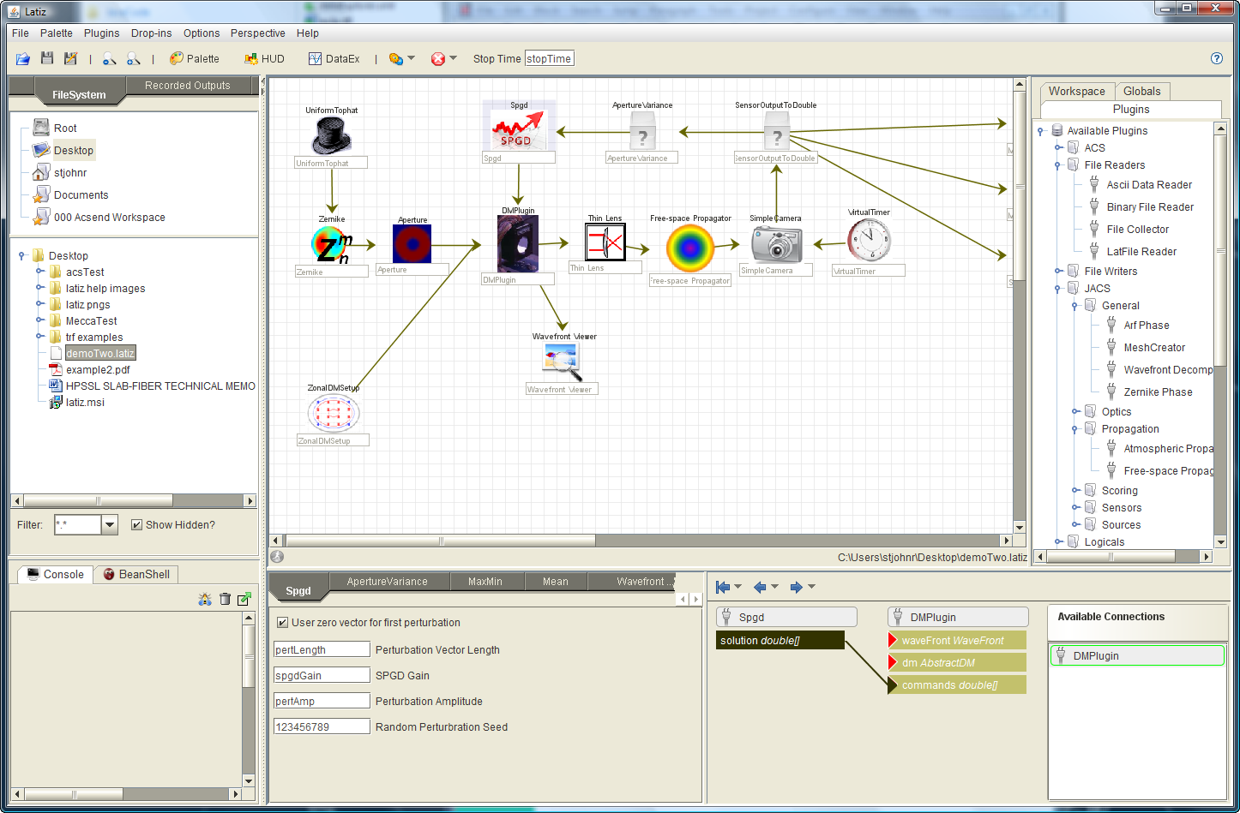
Latiz Palette Anatomy
File Shortcuts Panel
Available Plugins
Model Component
File System Panel
Connection Panel
Parameter Panel

Slide 3
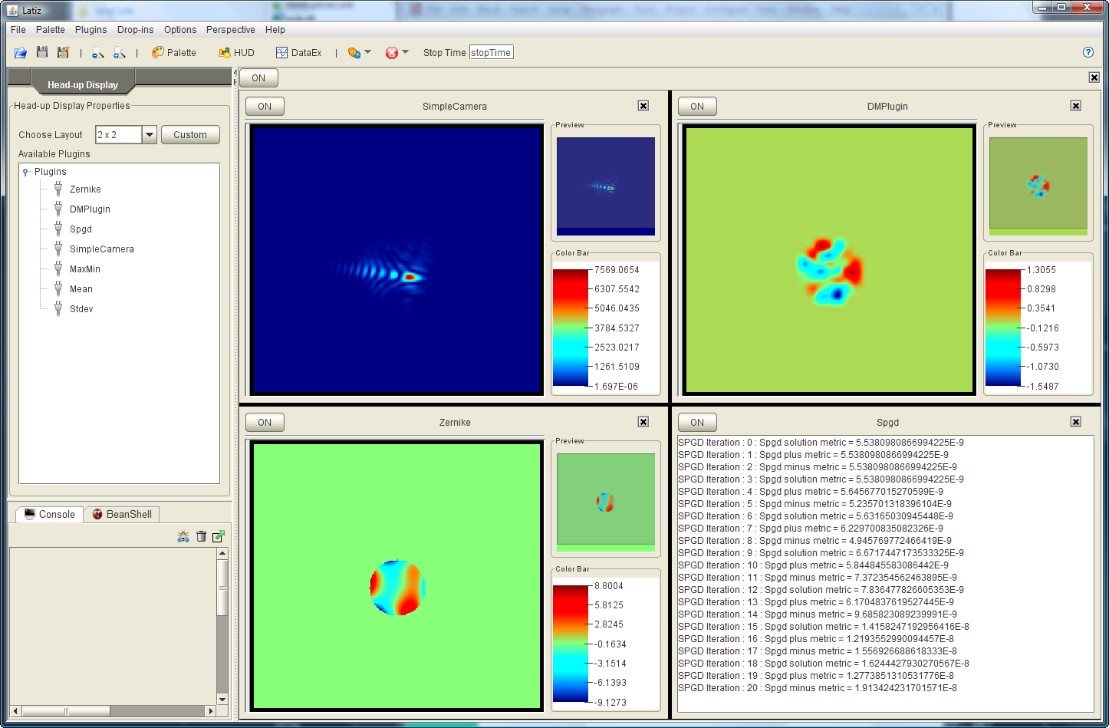
Head-Up Display Panel (HUD)
HUD Panel allows users customize the display of available data.
Can use pre-defined layouts or custom layout.
Drag-n-drop available plugins to an empty HUD component.
Can turn on/off.

Slide 4
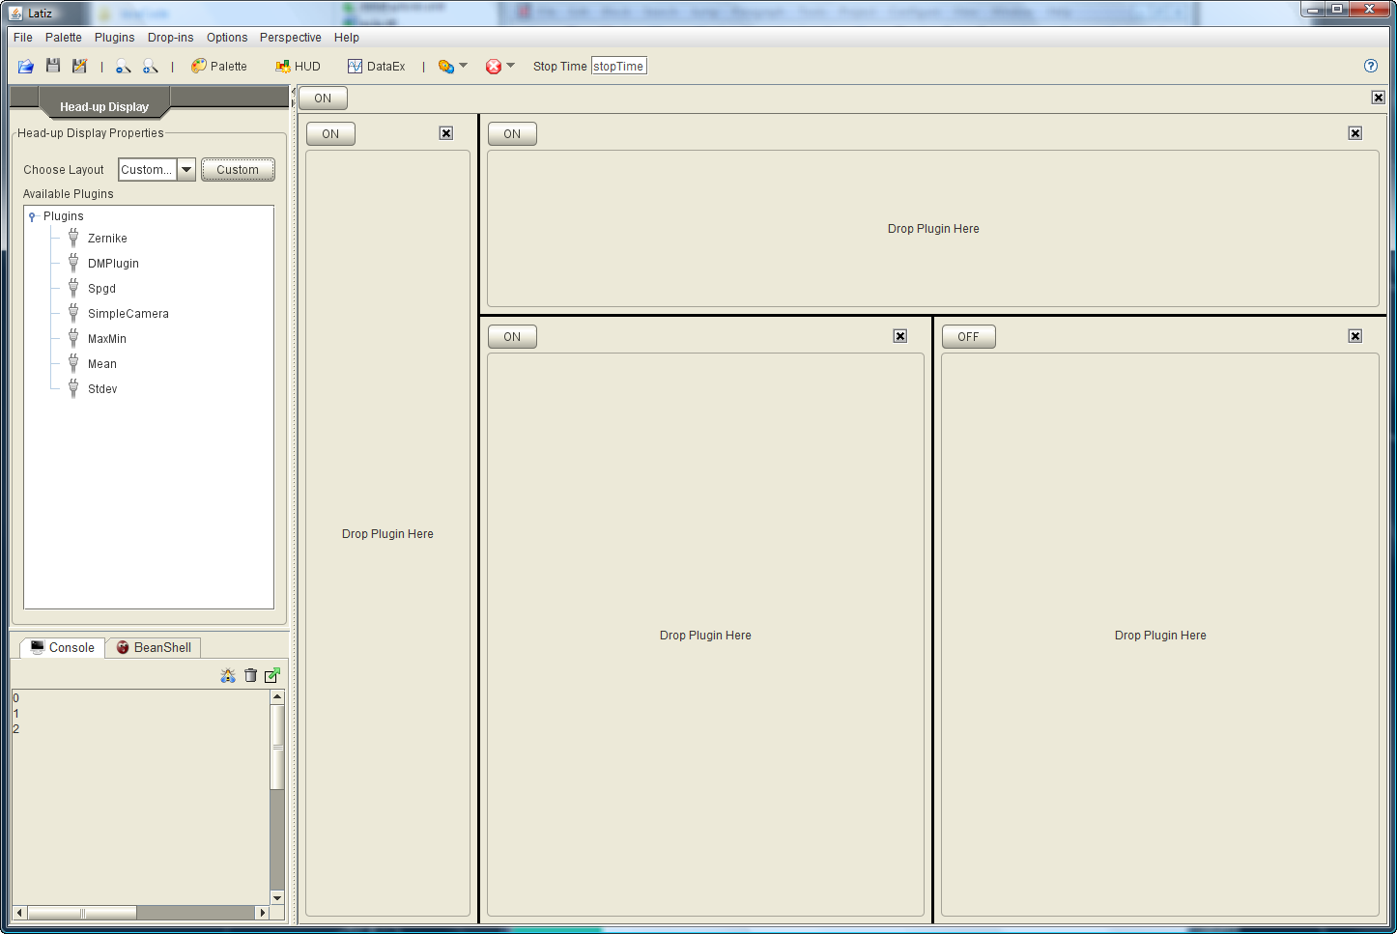
Custom HUD Panel
HUD Panel allows users customize the display of available data.
Can use pre-defined layouts or custom layout.
Drag-n-drop available plugins to an empty HUD component.
Can turn on/off.

Slide 5
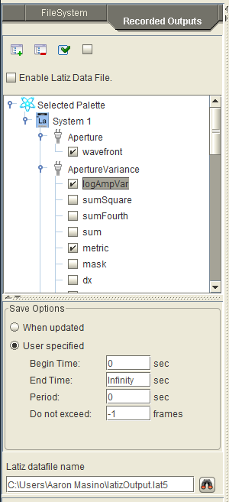
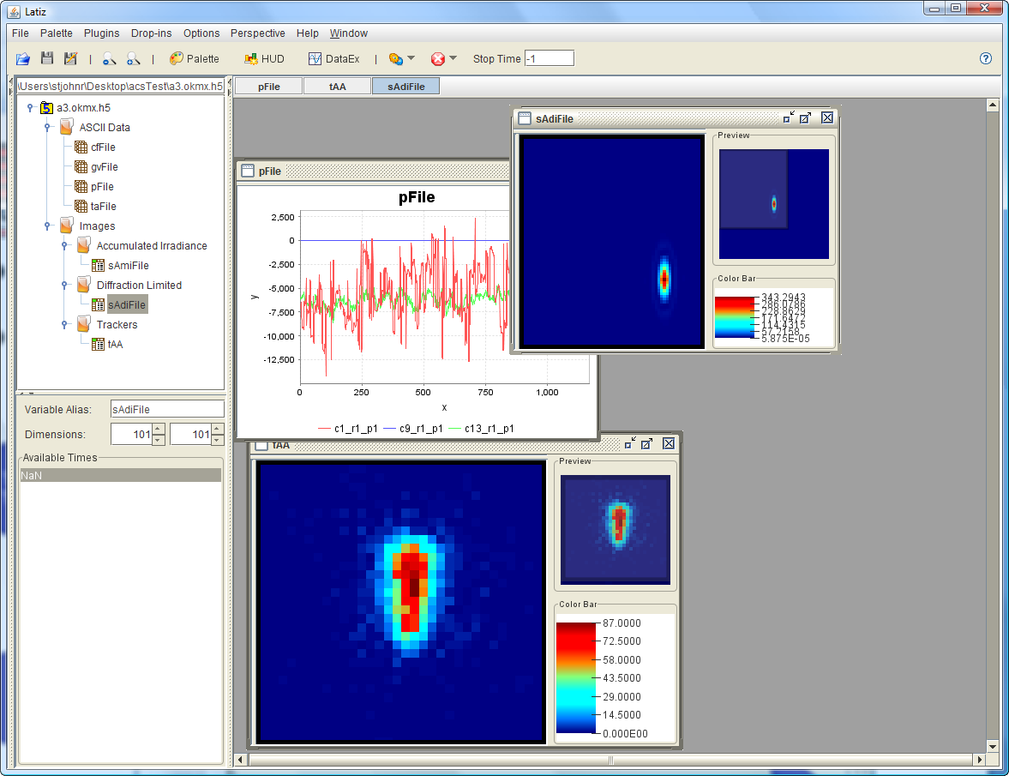
Recorded Outputs (Lat-file)
Recorded output is stored in the HDF5 file format.
Choose from each plugin’s available output to save to lat-file.
Previously recorded output can be accessed via the DataExplorer perspective
DataEx Perspective

Slide 6
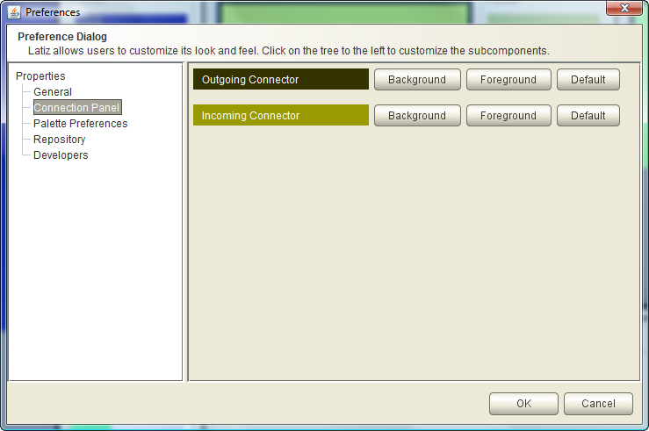
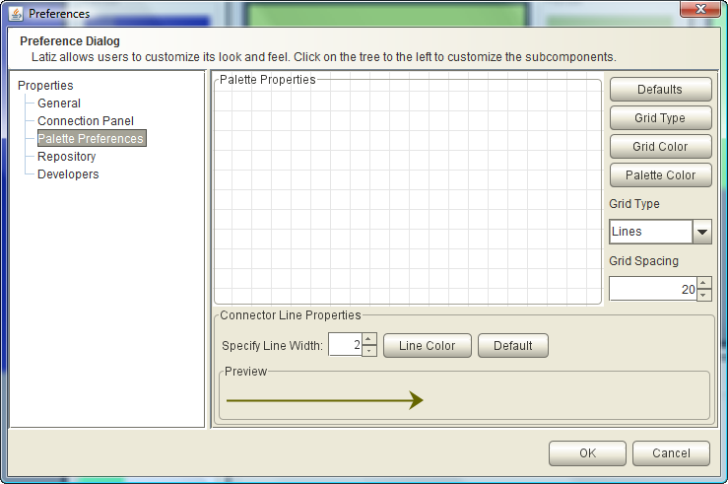
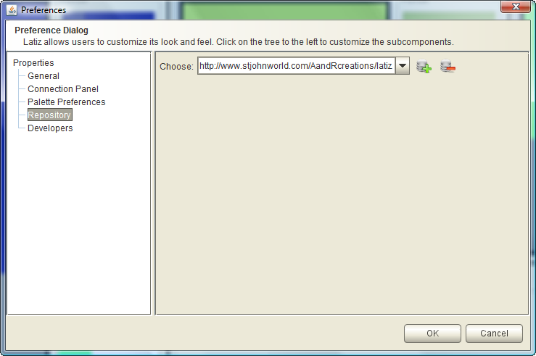
Latiz Preferences
Users can customize many aspect of the Latiz framework.

Slide 7
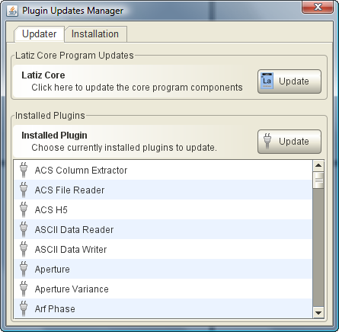
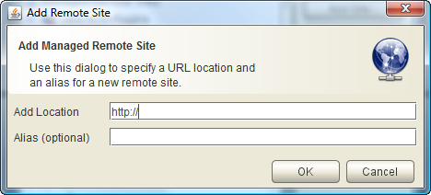
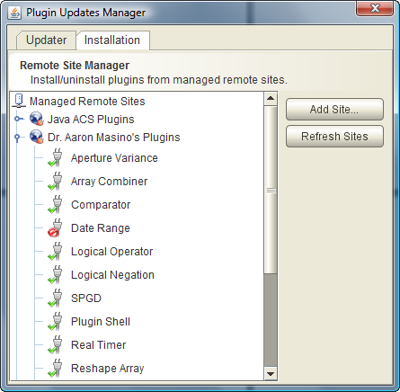
Latiz Update Manager
Updates Latiz core as well as installed plugins
Users can add and manage multiple remote plugin sites.

Slide 8
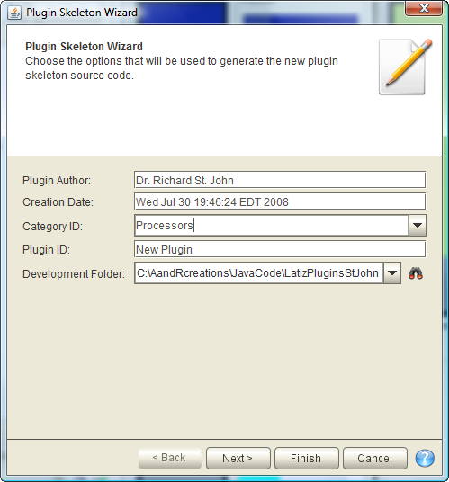
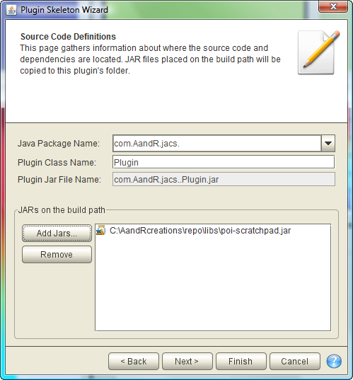
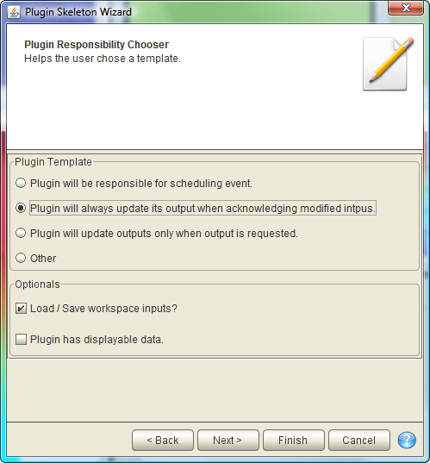
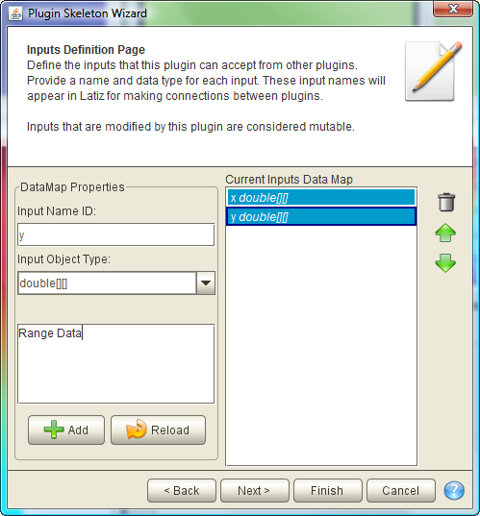
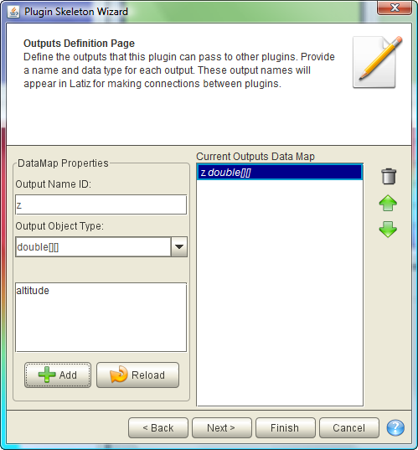
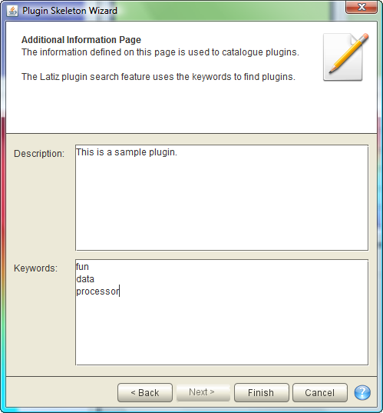
New Plugin Wizard
Six easy steps to create a new plugin skeleton
1
2
3
4
5
6

Slide 9
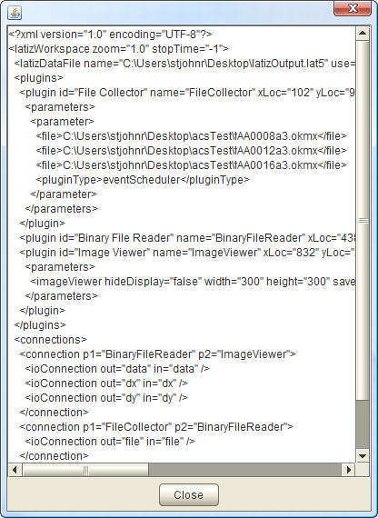
Latiz Workspace File
XML-based latiz workspace file.
Latiz can be run in headless mode on a remote machine.

Slide 10
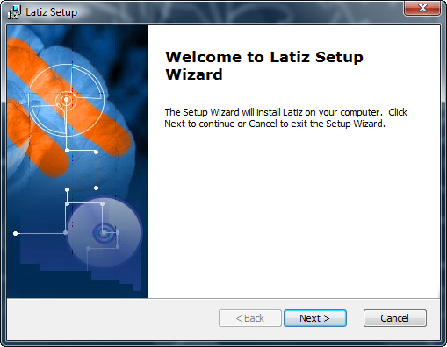
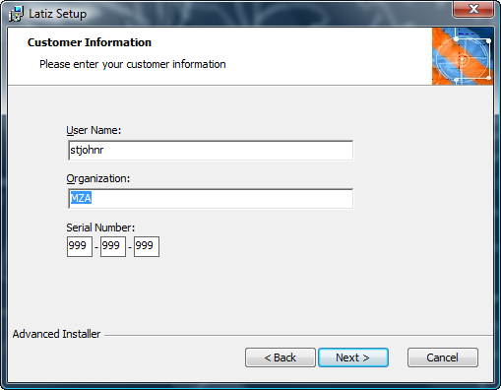
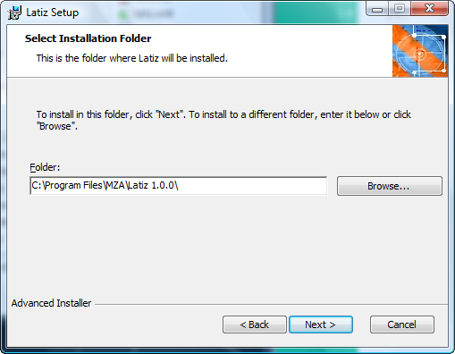
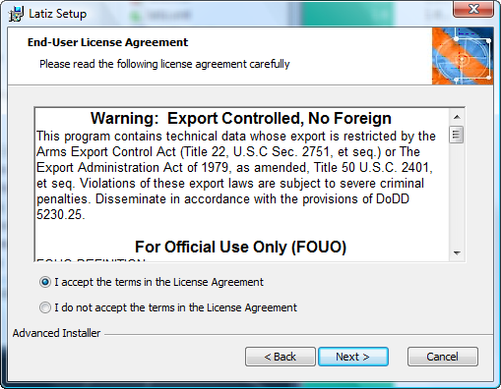
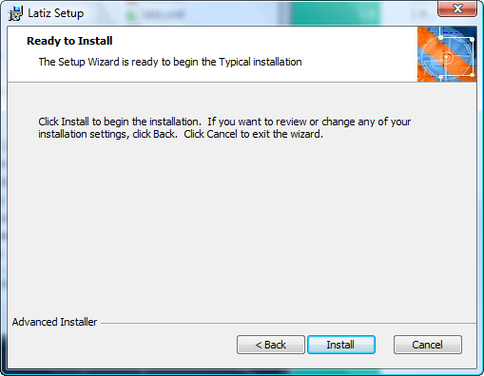
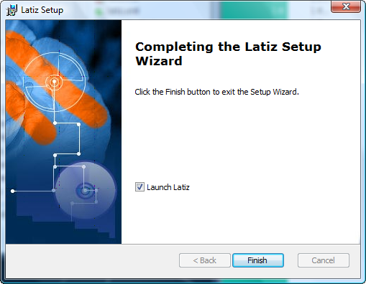
Latiz Installation
Latiz installation breakdown
1
2
3
4
5
6

Slide 11
Create Mecca Jobs
Mecca jobs can be create from the globals table.
A loop is created by using any syntax below:
  $loop=[“3”, “4”, “b”]
    ALL entries must be enclosed in double-quotes.
  $loop=[4,3,5,fun,7] when splitting on comma is valid.
    Note that the entry does NOT contain any double-quotes.

